Slide 1
Session 9 FACTORIAL DESIGN

Slide 2
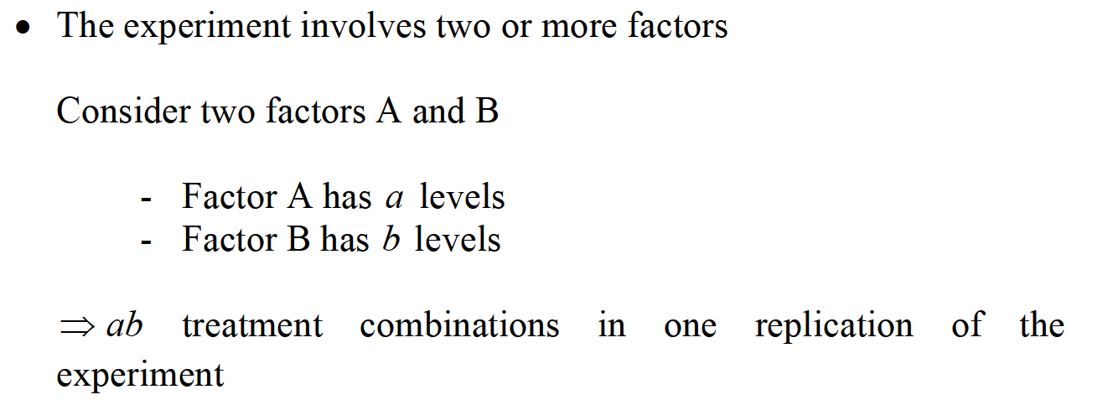
DEFINITIONS AND PRINCIPLES

Slide 3
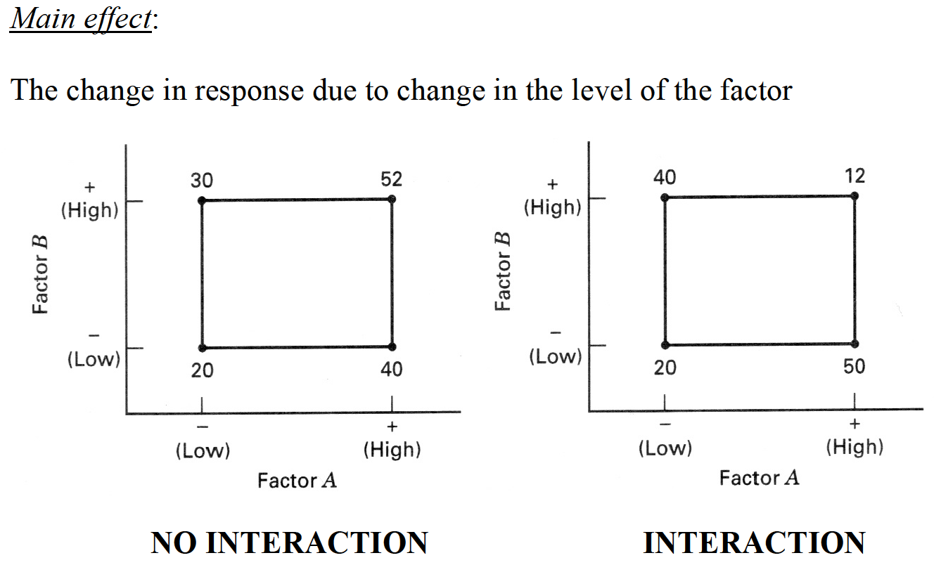
DEFINITIONS AND PRINCIPLES

Slide 4
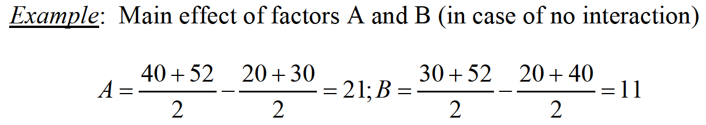
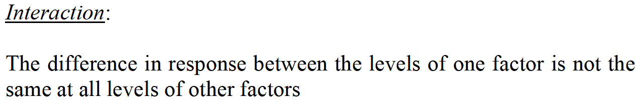
DEFINITIONS AND PRINCIPLES

Slide 5
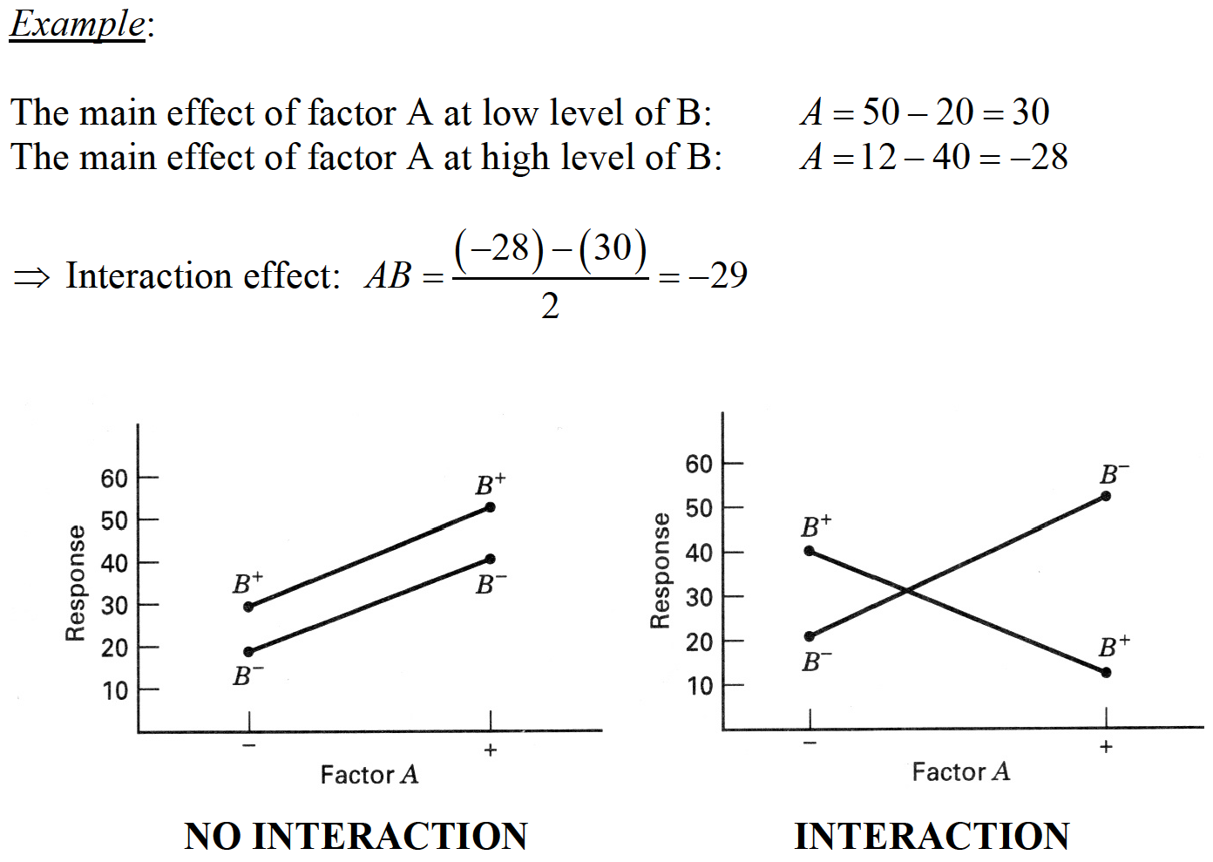
DEFINITIONS AND PRINCIPLES

Slide 6
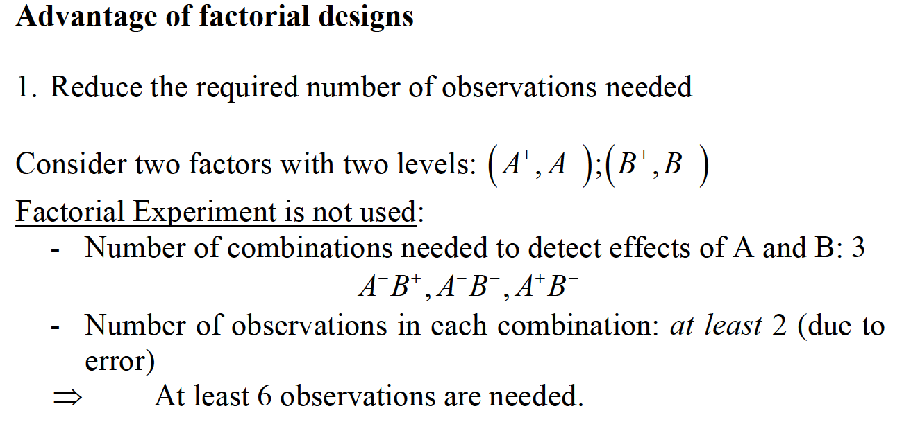
DEFINITIONS AND PRINCIPLES

Slide 7
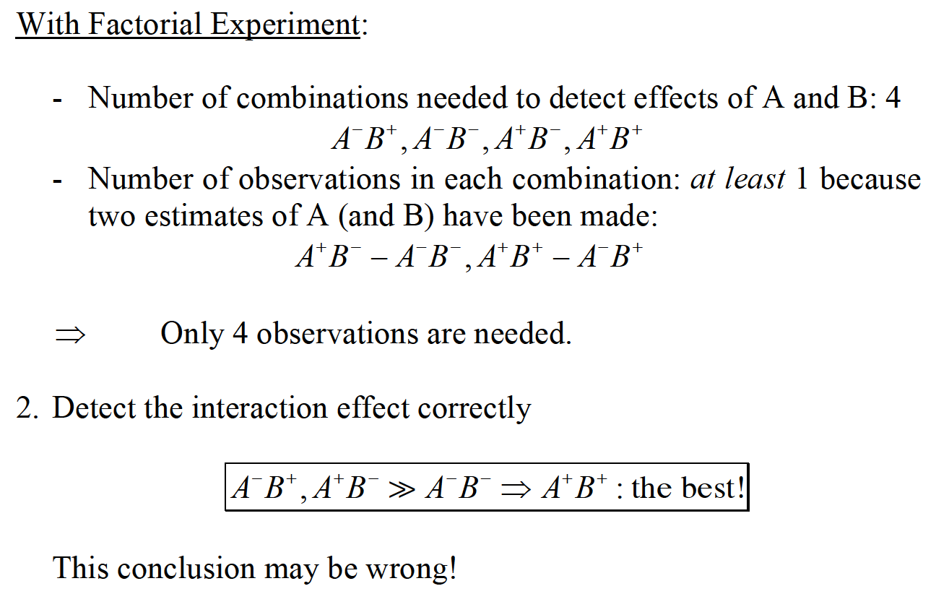
DEFINITIONS AND PRINCIPLES

Slide 8
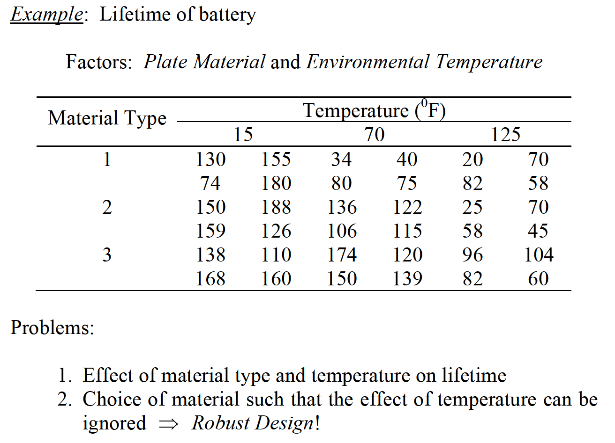
TWO-FACTOR FACTORIAL DESIGN

Slide 9
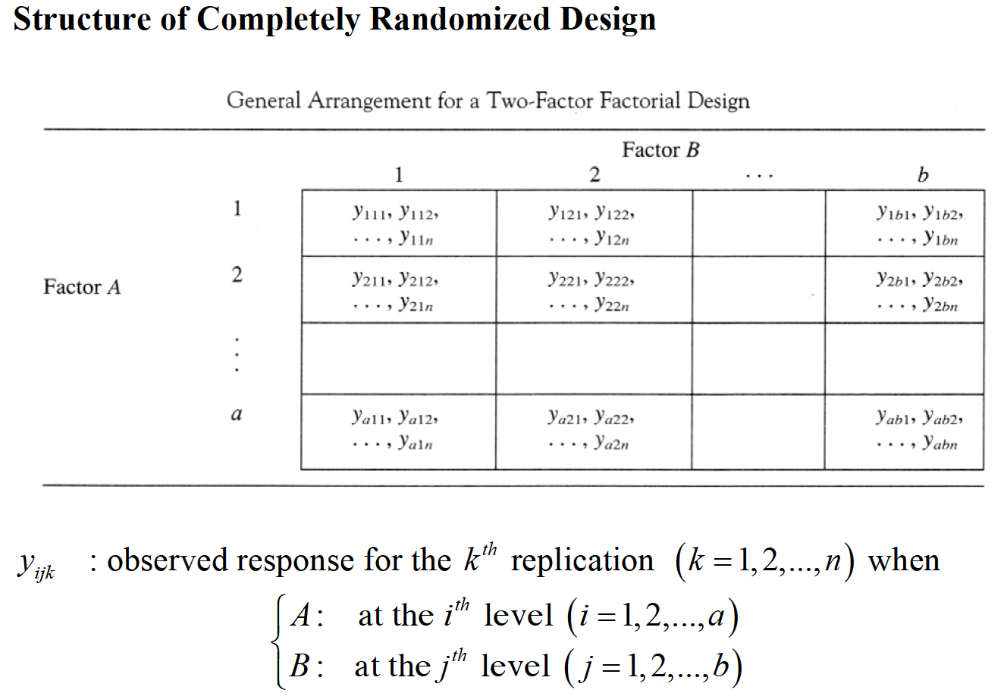
TWO-FACTOR FACTORIAL DESIGN

Slide 10
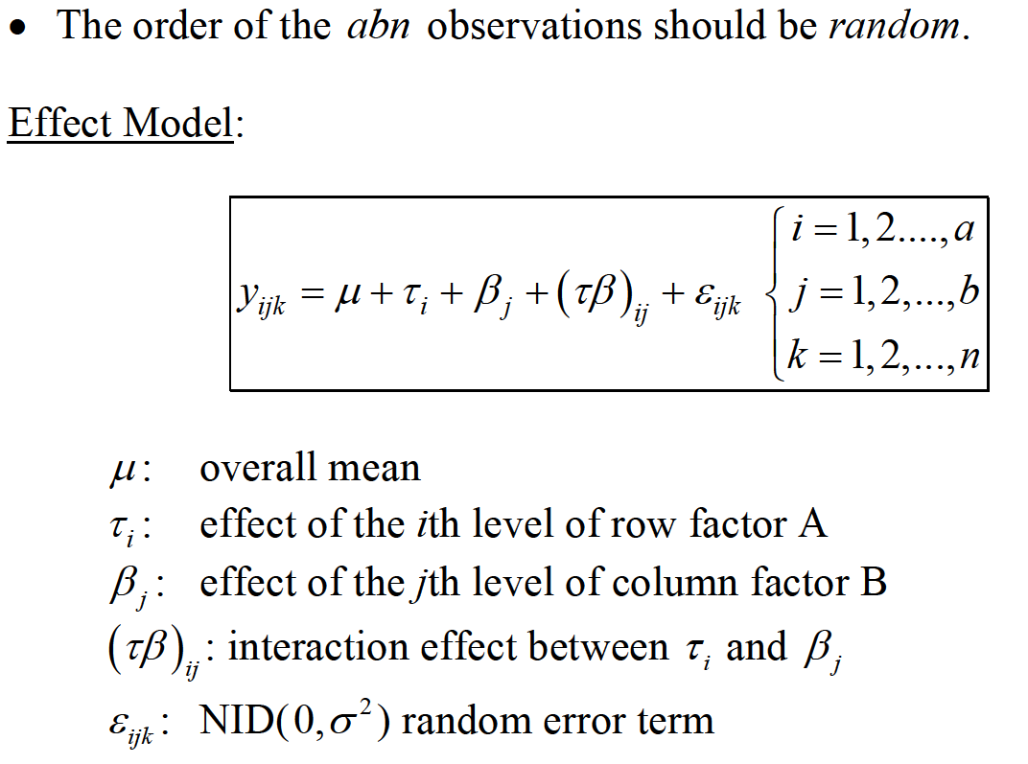
TWO-FACTOR FACTORIAL DESIGN

Slide 11
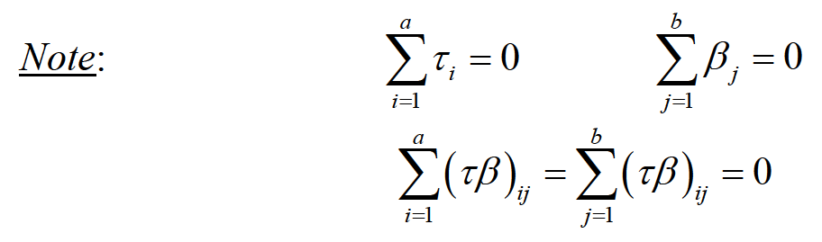
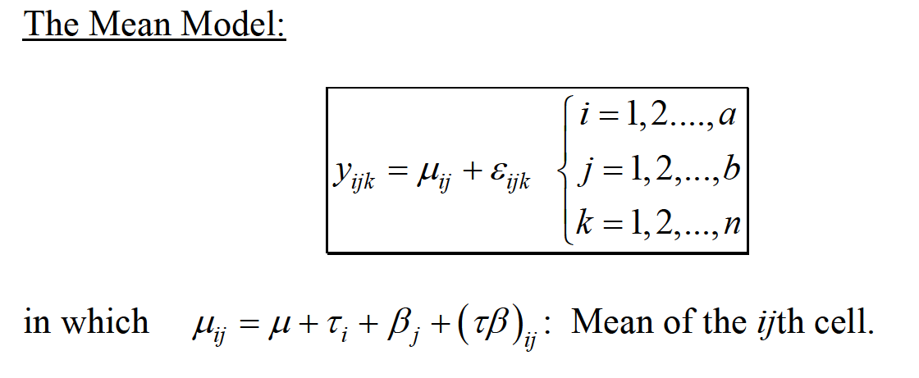
TWO-FACTOR FACTORIAL DESIGN

Slide 12
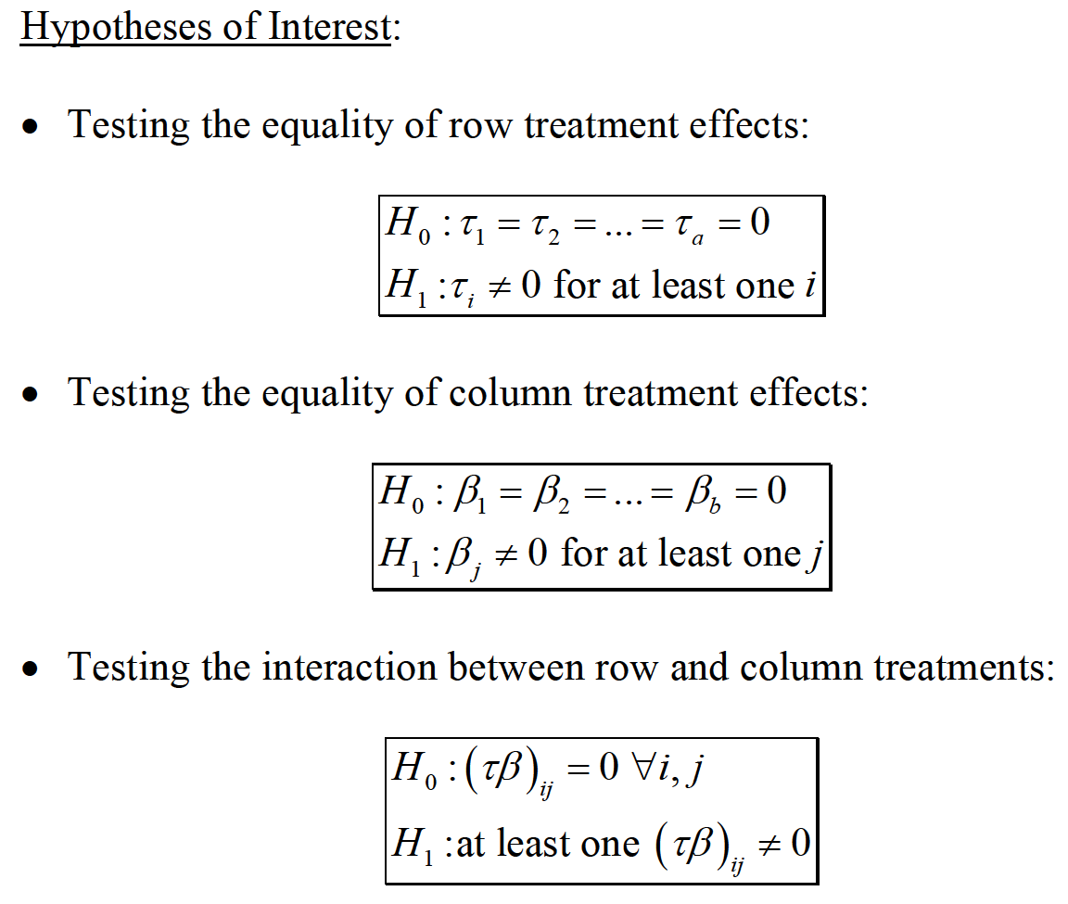
TWO-FACTOR FACTORIAL DESIGN

Slide 13
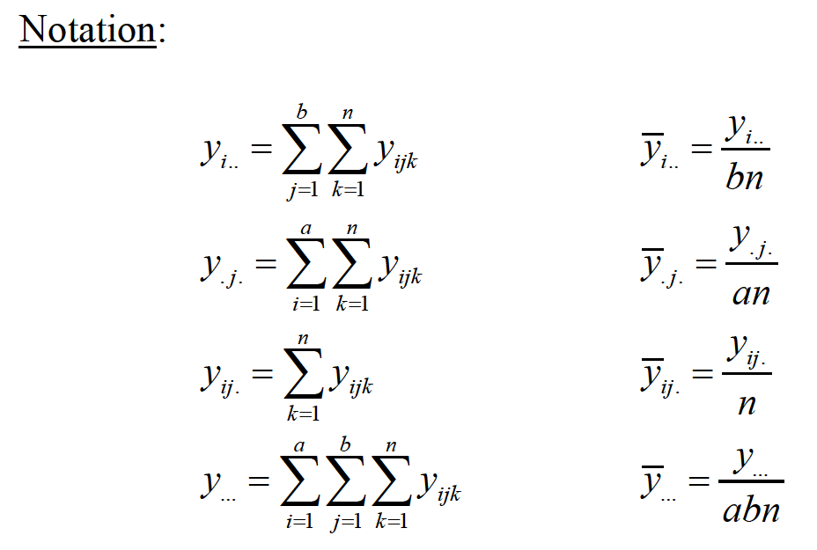
TWO-FACTOR FACTORIAL DESIGN

Slide 14
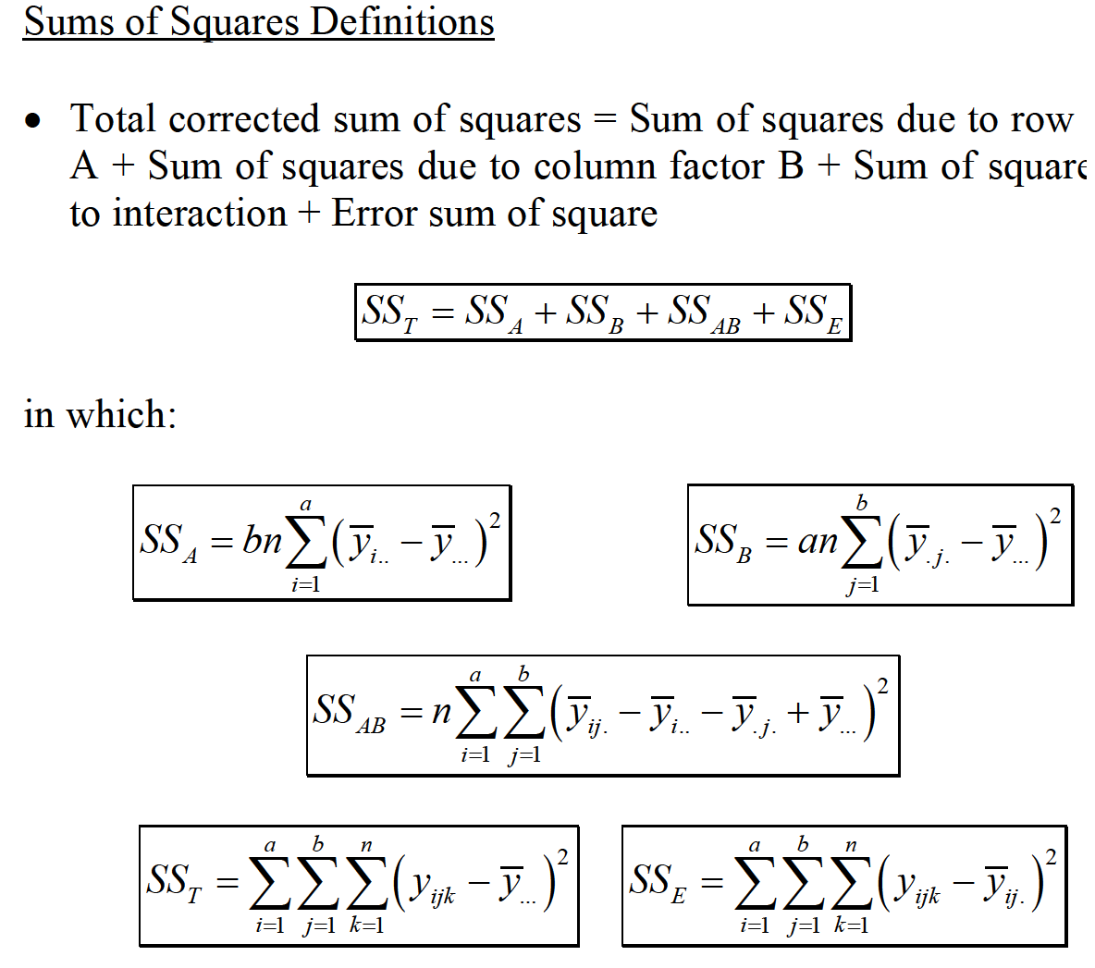
TWO-FACTOR FACTORIAL DESIGN

Slide 15
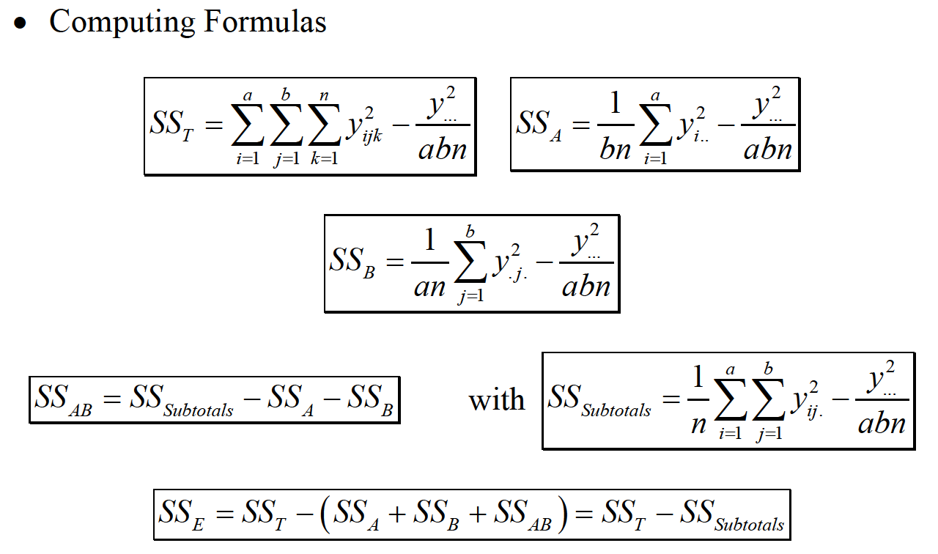
TWO-FACTOR FACTORIAL DESIGN

Slide 16
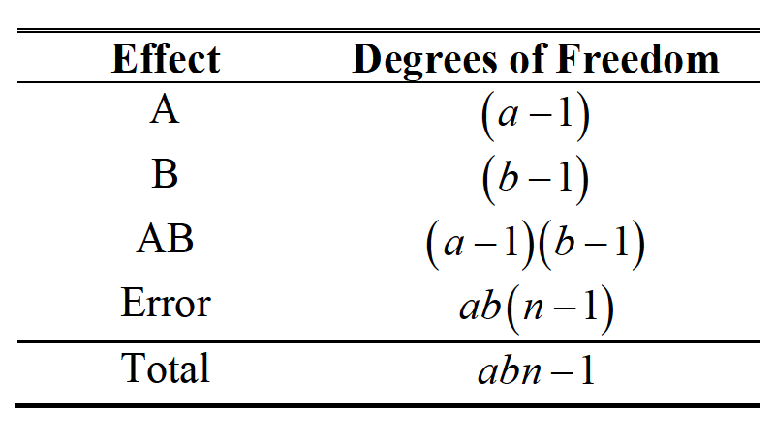
TWO-FACTOR FACTORIAL DESIGN

Slide 17
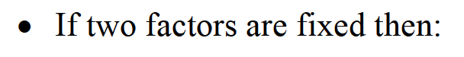
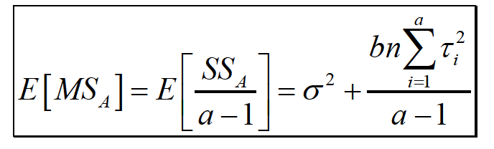
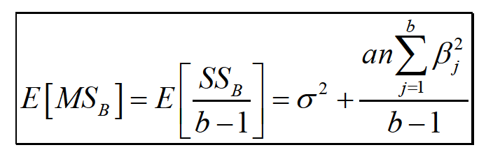
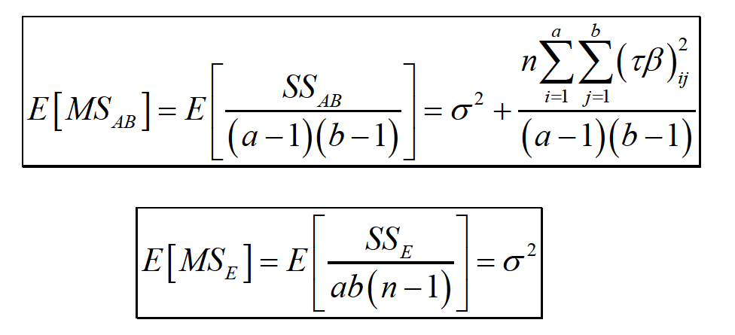
TWO-FACTOR FACTORIAL DESIGN

Slide 18
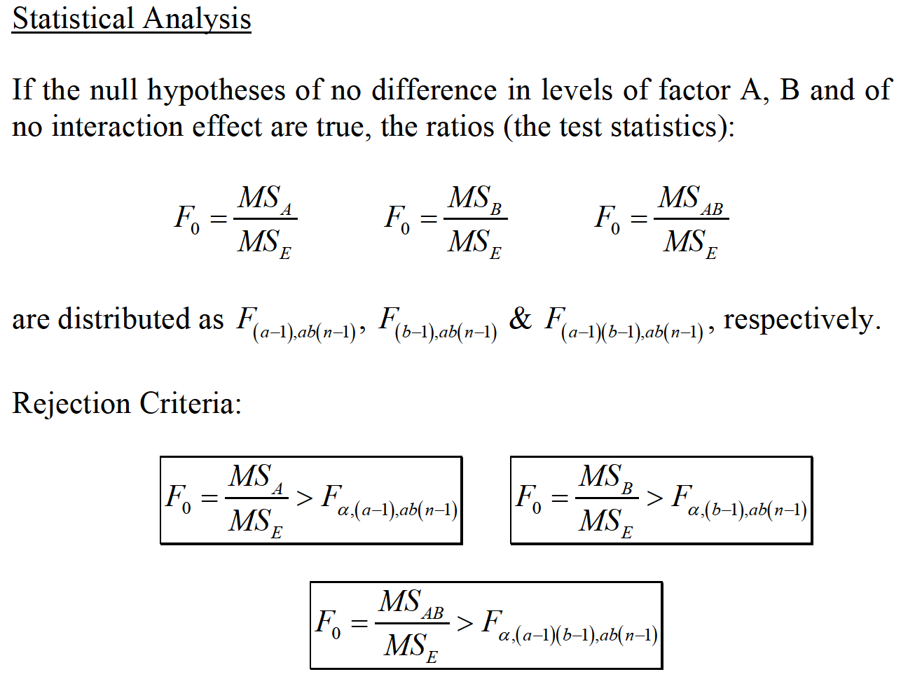
TWO-FACTOR FACTORIAL DESIGN

Slide 19
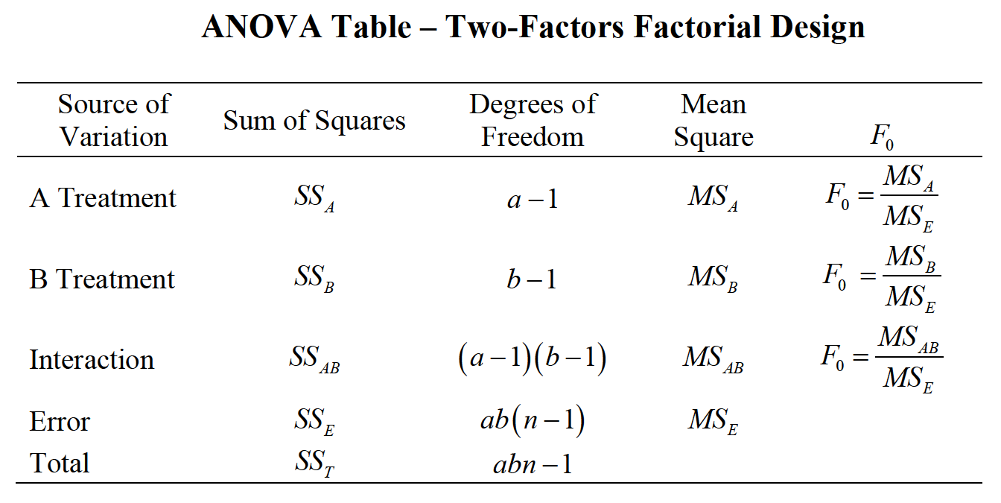
TWO-FACTOR FACTORIAL DESIGN

Slide 20
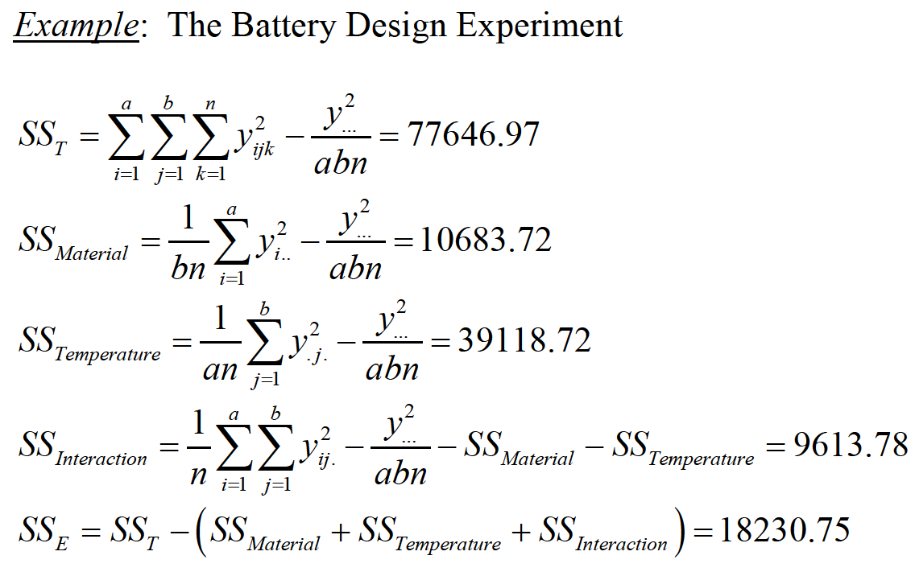
TWO-FACTOR FACTORIAL DESIGN

Slide 21
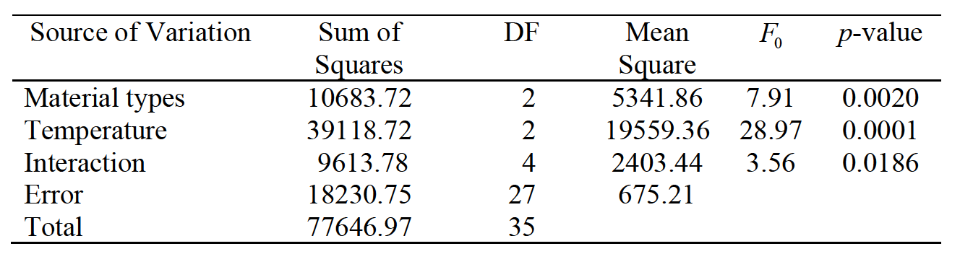
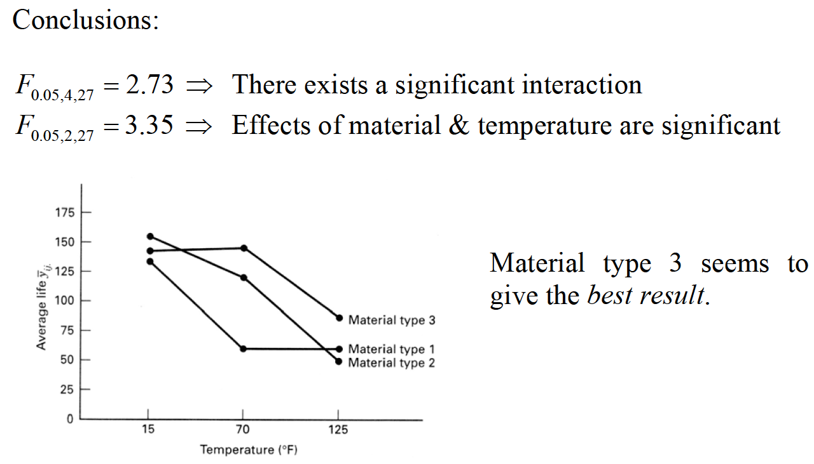
TWO-FACTOR FACTORIAL DESIGN

Slide 22
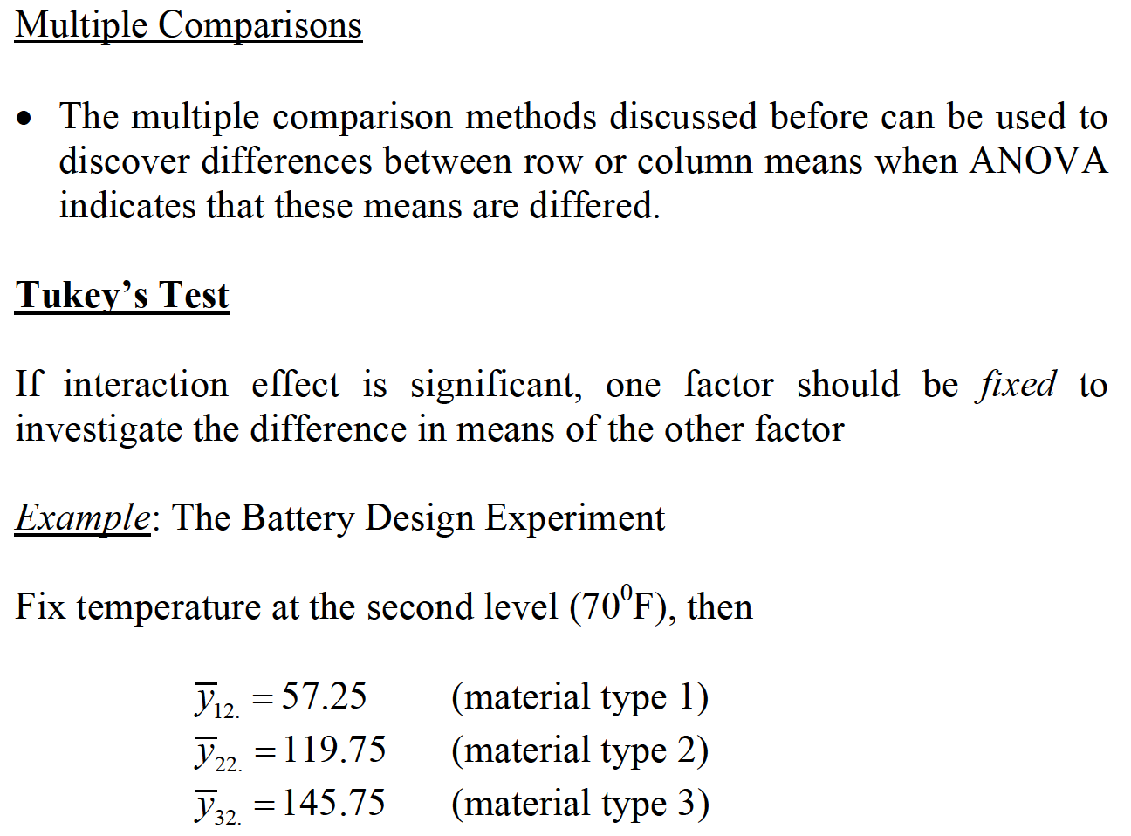
TWO-FACTOR FACTORIAL DESIGN

Slide 23
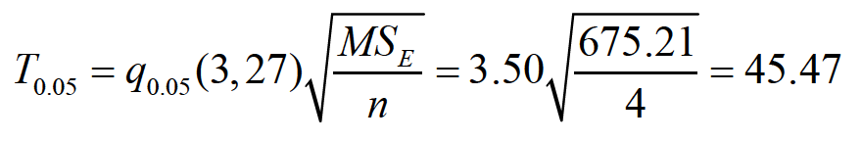
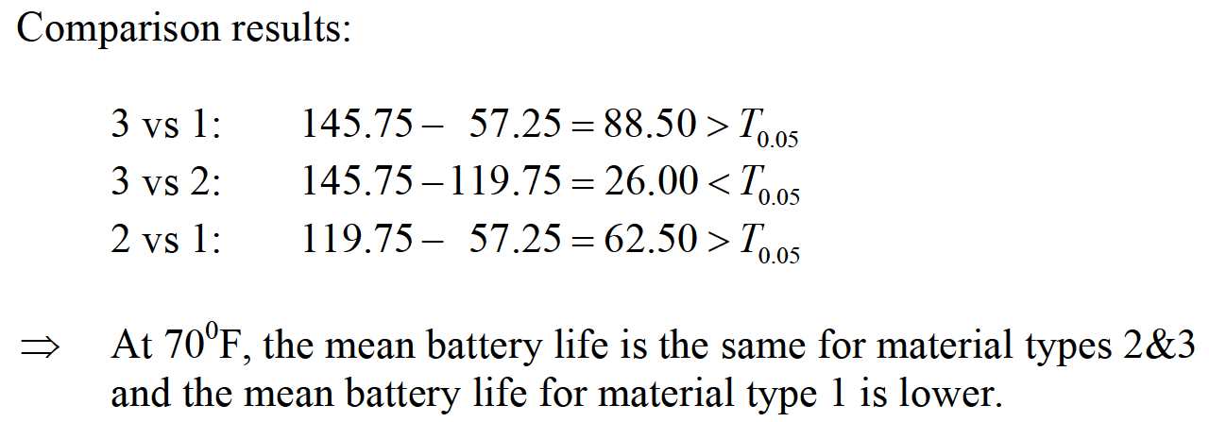
TWO-FACTOR FACTORIAL DESIGN

Slide 24
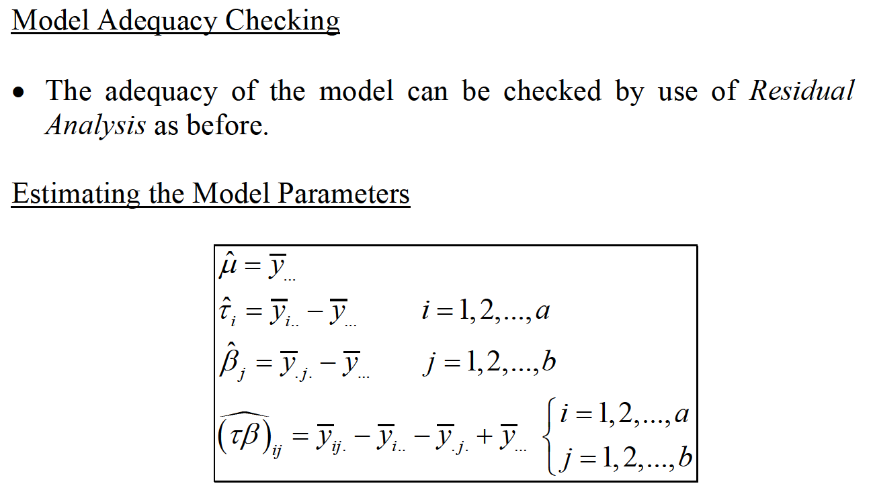
TWO-FACTOR FACTORIAL DESIGN

Slide 25
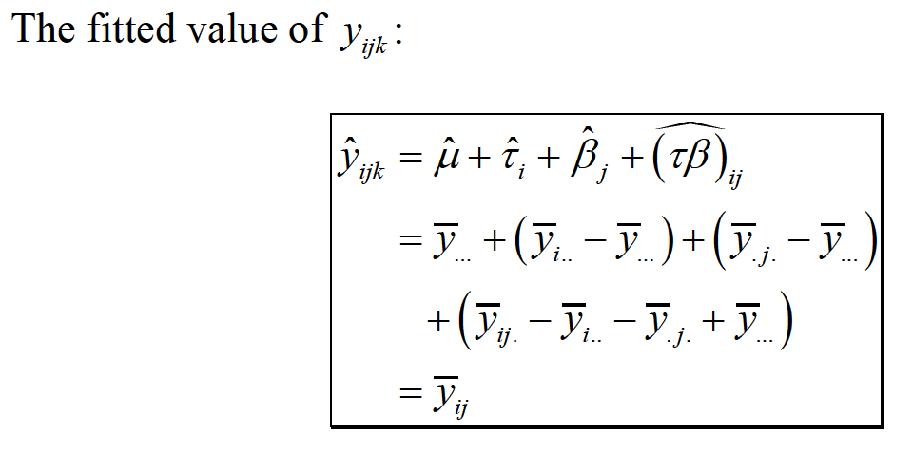
TWO-FACTOR FACTORIAL DESIGN

Slide 26
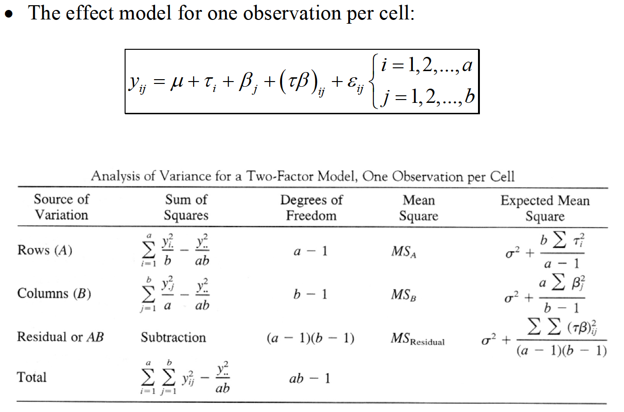
TWO-FACTOR FACTORIAL DESIGN ONE OBSERVATION PER CELL

Slide 27
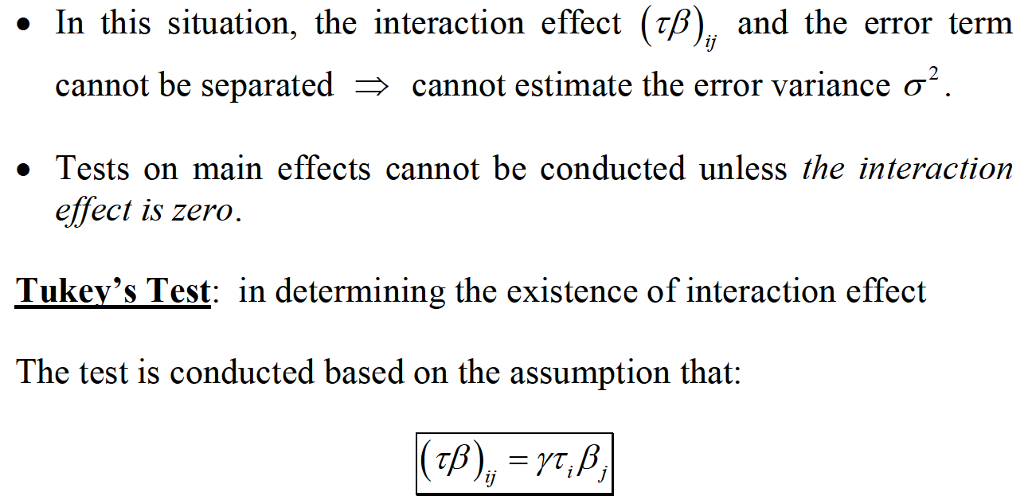
TWO-FACTOR FACTORIAL DESIGN ONE OBSERVATION PER CELL

Slide 28
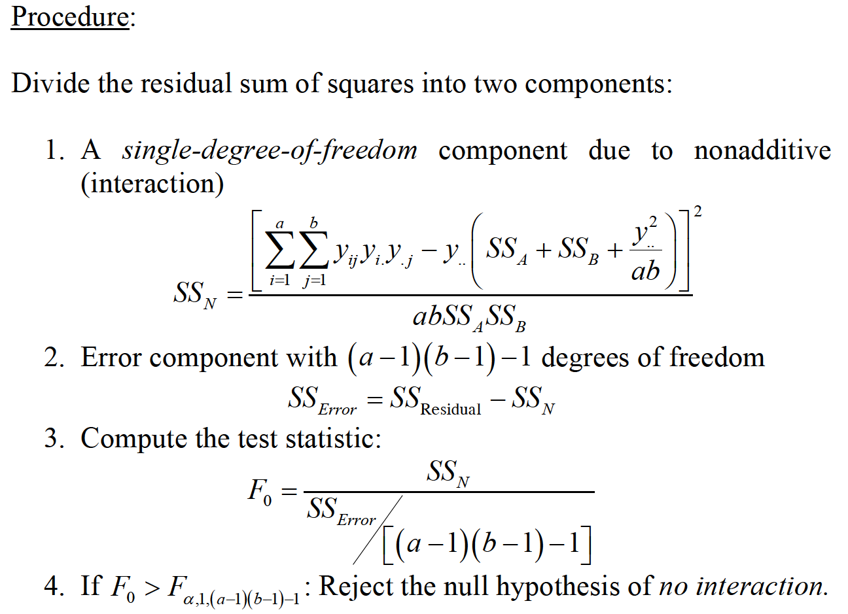
TWO-FACTOR FACTORIAL DESIGN ONE OBSERVATION PER CELL

Slide 29
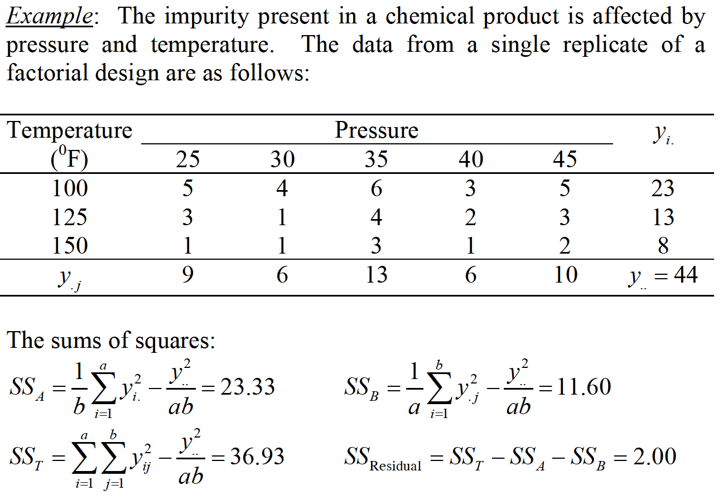
TWO-FACTOR FACTORIAL DESIGN ONE OBSERVATION PER CELL

Slide 30
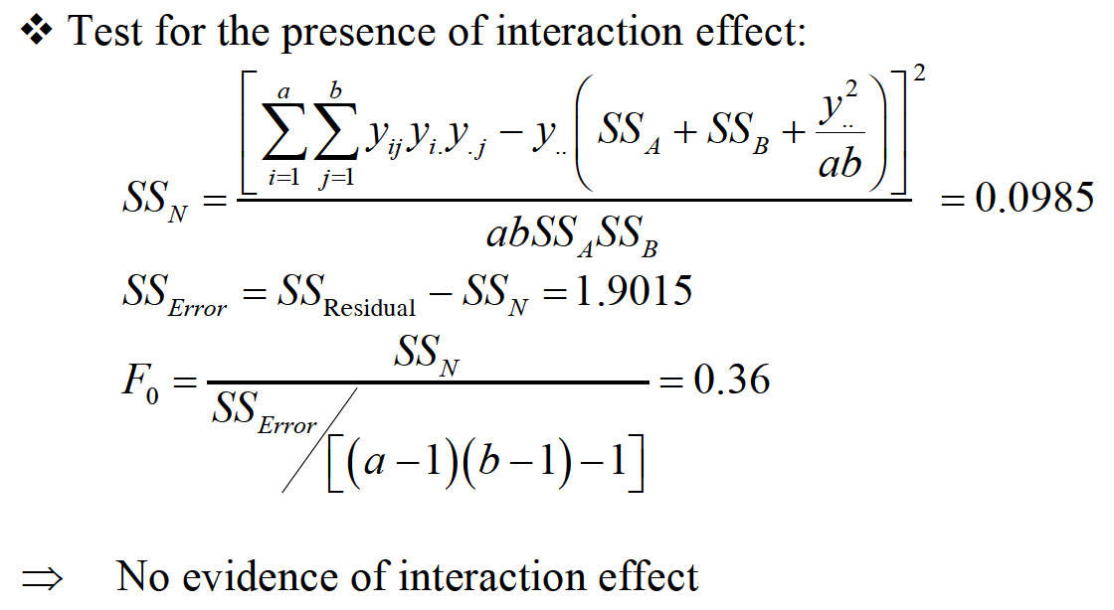
TWO-FACTOR FACTORIAL DESIGN ONE OBSERVATION PER CELL

Slide 31
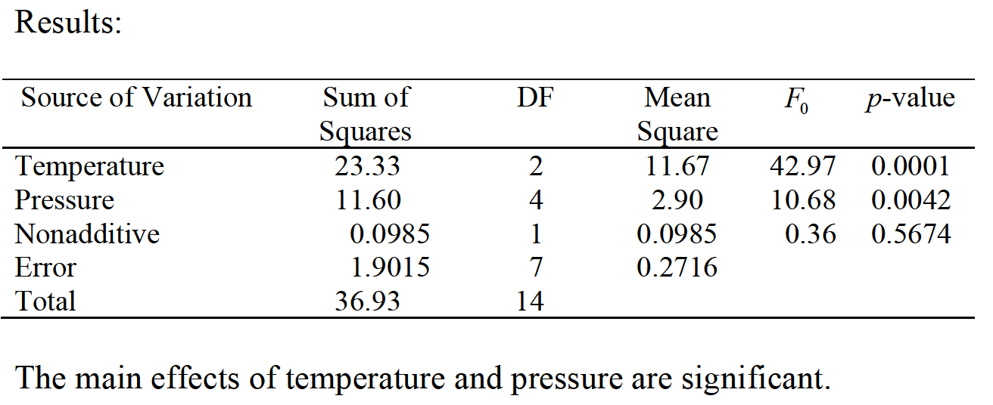
TWO-FACTOR FACTORIAL DESIGN ONE OBSERVATION PER CELL

Slide 32
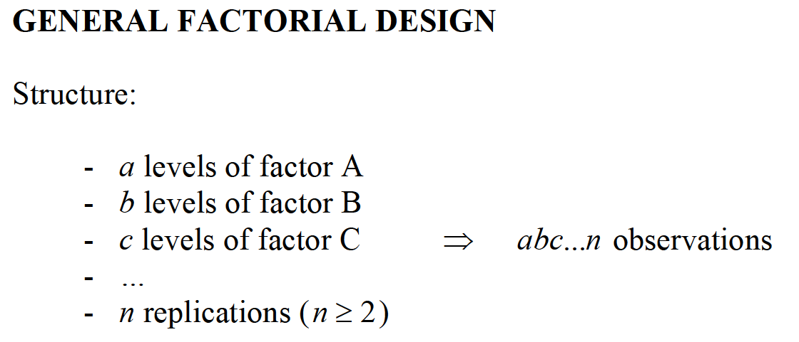
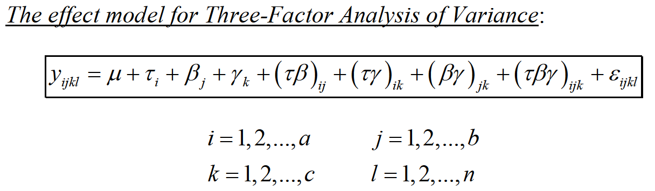
GENERAL FACTORIAL DESIGN

Slide 33
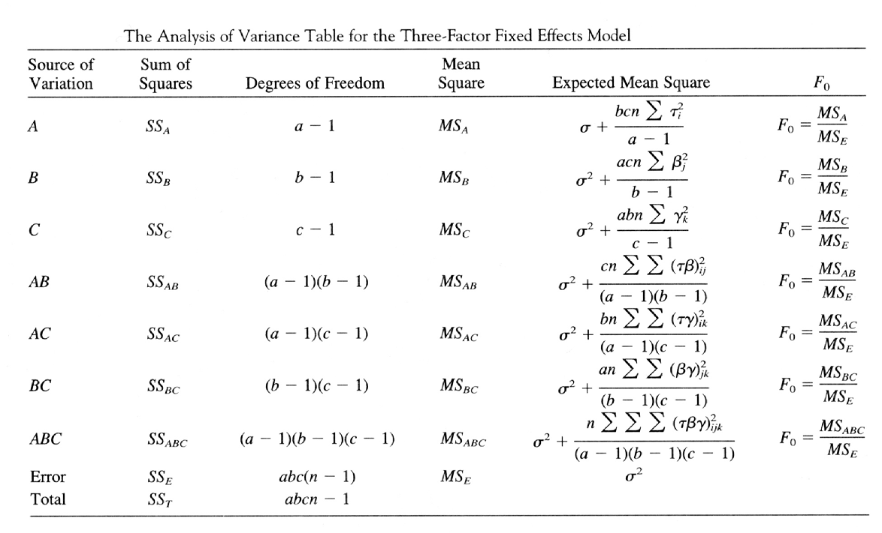
GENERAL FACTORIAL DESIGN

Slide 34
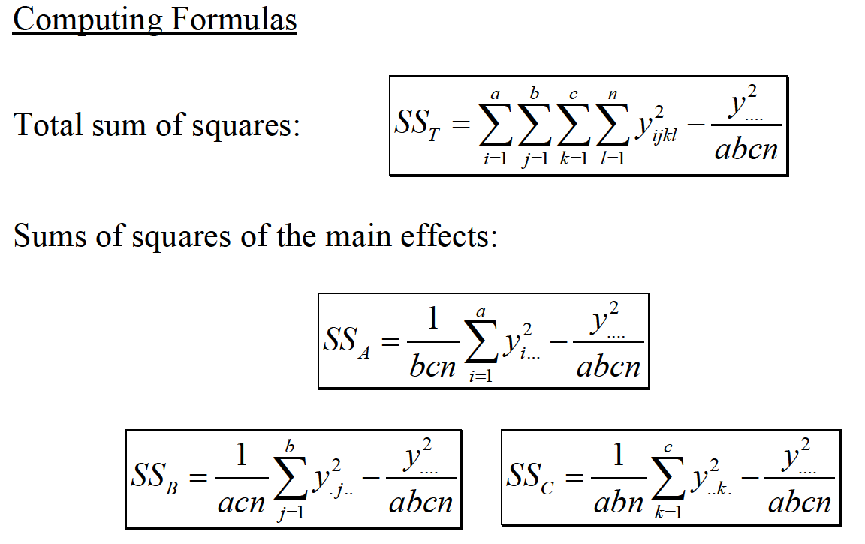
GENERAL FACTORIAL DESIGN

Slide 35
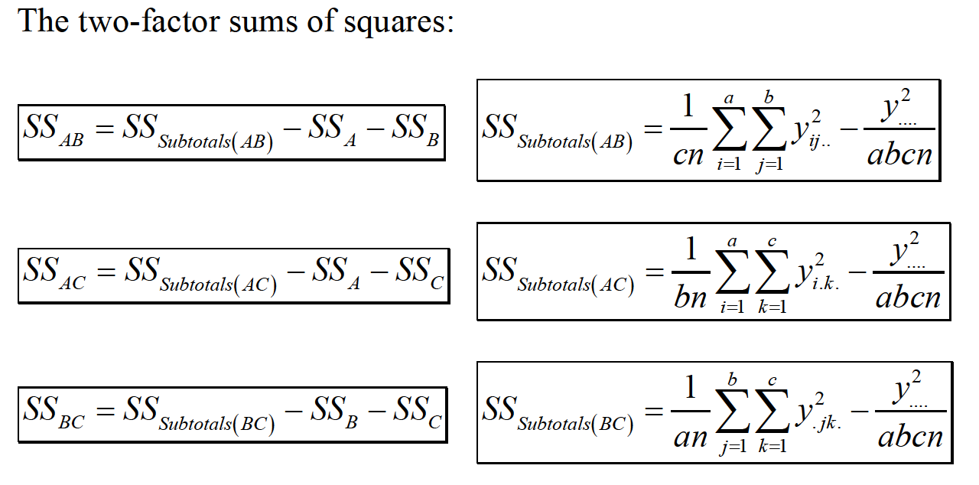
GENERAL FACTORIAL DESIGN

Slide 36
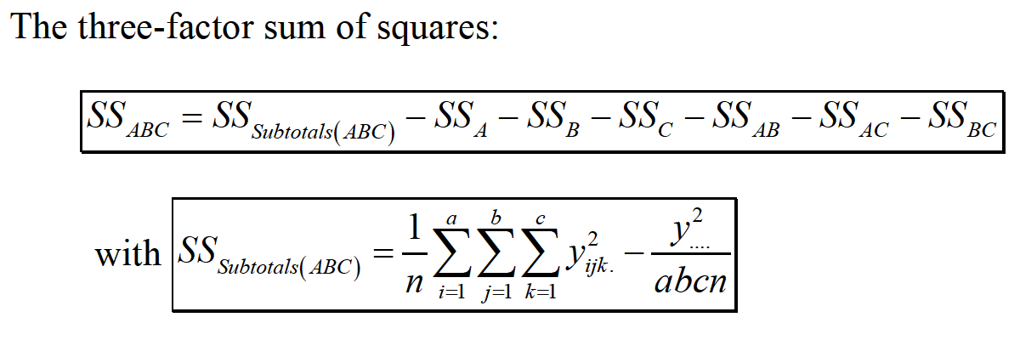
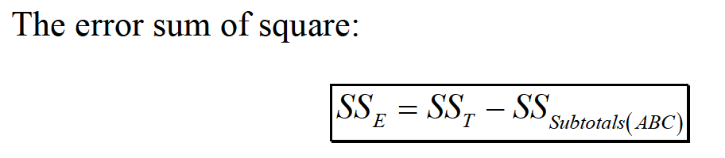
GENERAL FACTORIAL DESIGN

Slide 37
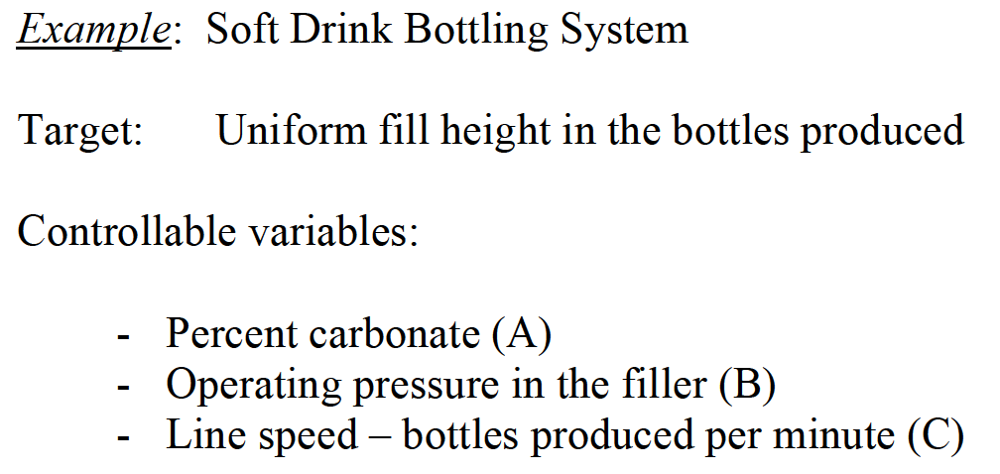
GENERAL FACTORIAL DESIGN

Slide 38
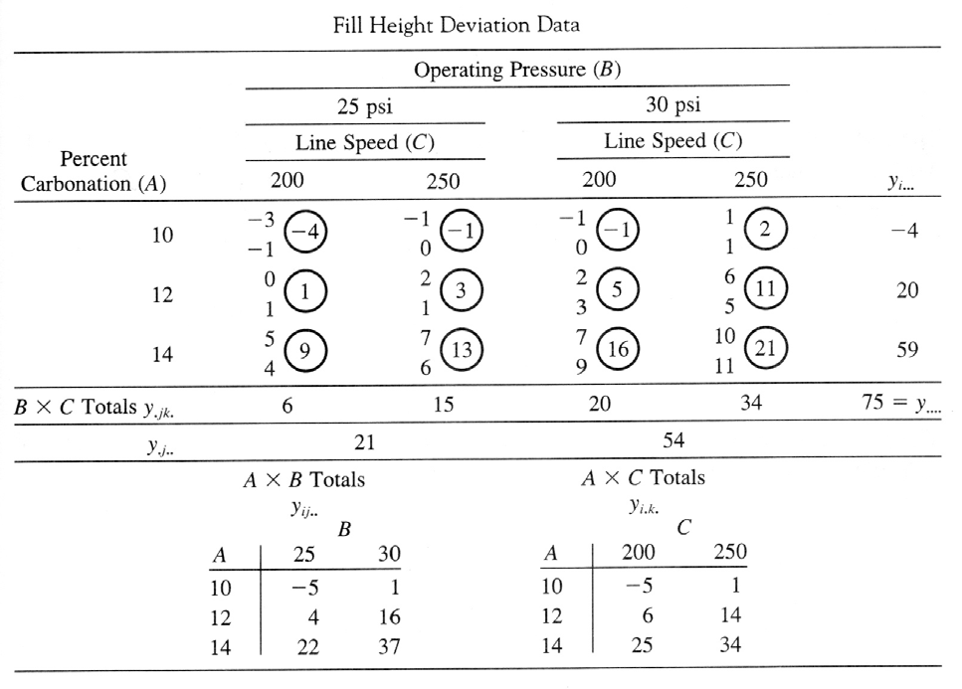
GENERAL FACTORIAL DESIGN

Slide 39
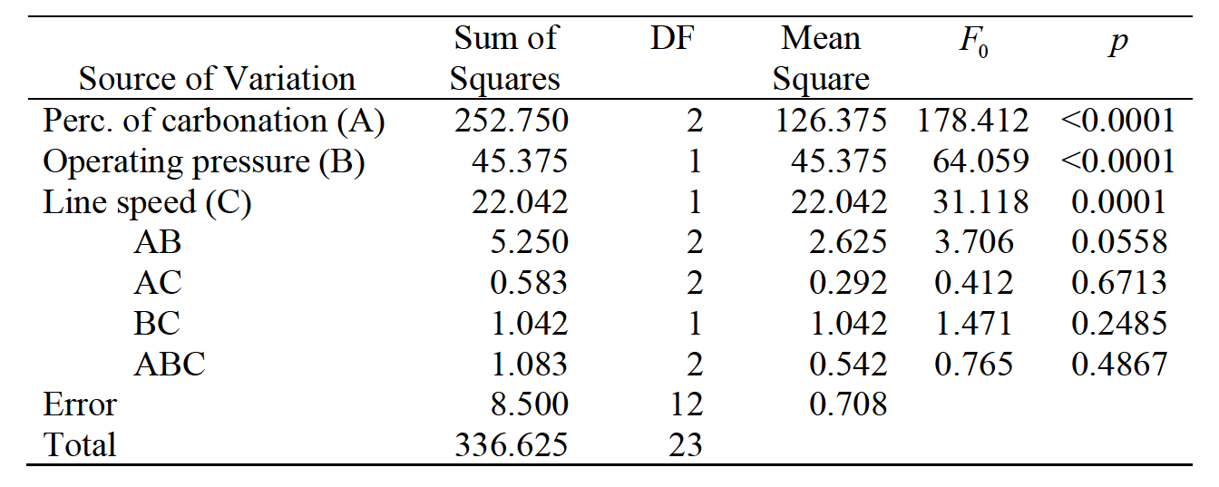
GENERAL FACTORIAL DESIGN

Slide 40
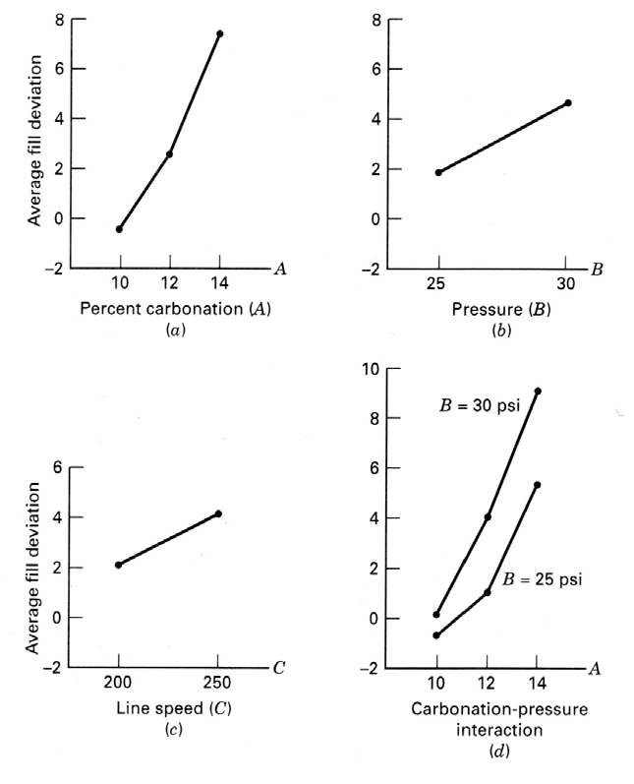
GENERAL FACTORIAL DESIGN

Slide 41
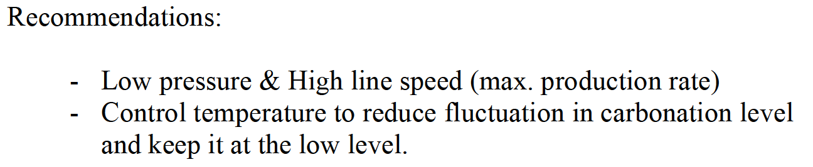
GENERAL FACTORIAL DESIGN

Slide 42
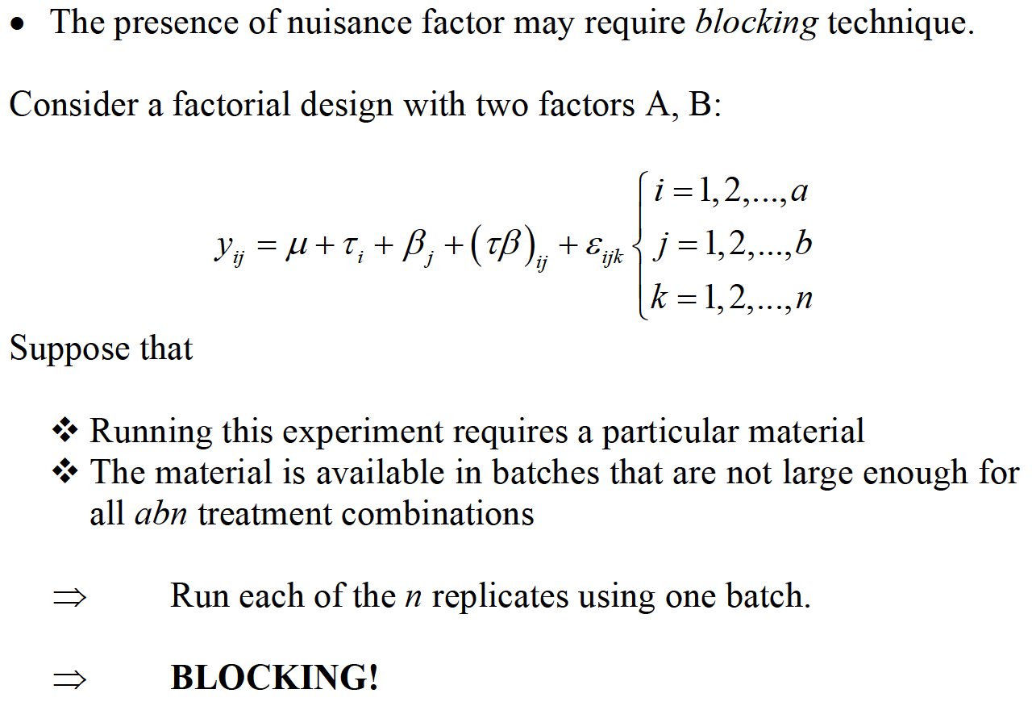
BLOCKING IN FACTORIAL DESIGN

Slide 43

BLOCKING IN FACTORIAL DESIGN

Slide 44

BLOCKING IN FACTORIAL DESIGN

Slide 45

BLOCKING IN FACTORIAL DESIGN

Slide 46

BLOCKING IN FACTORIAL DESIGN

Slide 47

BLOCKING IN FACTORIAL DESIGN

Slide 48

BLOCKING IN FACTORIAL DESIGN

Slide 49

BLOCKING IN FACTORIAL DESIGN

Slide 50

BLOCKING IN FACTORIAL DESIGN

Slide 51

BLOCKING IN FACTORIAL DESIGN

Slide 52

BLOCKING IN FACTORIAL DESIGN

